Slide 1
BIOETHICS
STEM CELLS
Pr. Tsybusov Sergey Nikolaevich

Slide 2
A stem cell is an immature cell capable of rapid division, self-renewal and development into specialized cells of the body.
Stem cells, having received signals from regulatory systems about some kind of “malfunction”, rush to the affected organ through the blood stream. They can repair almost any damage, turning in place into cells necessary for the body. In the adult body, stem cells are located mainly in the bone marrow, as well as in all organs and tissues.

Slide 3
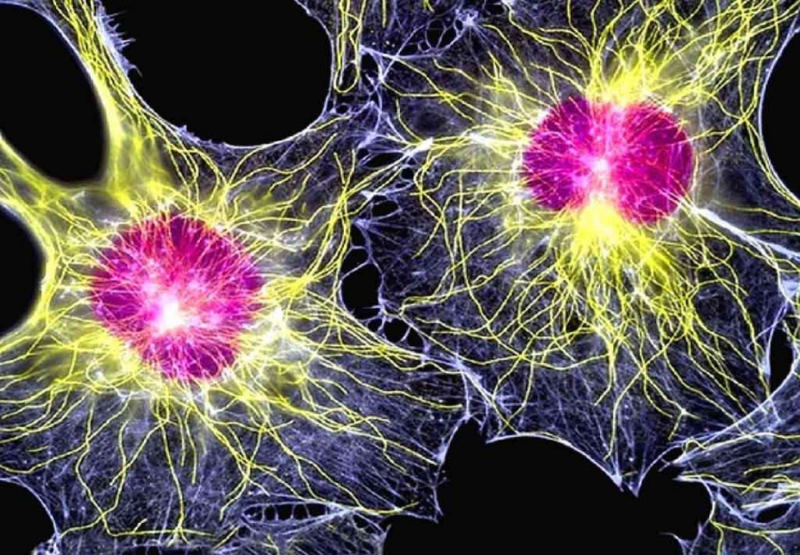
That's what a stem cell looks like

Slide 4
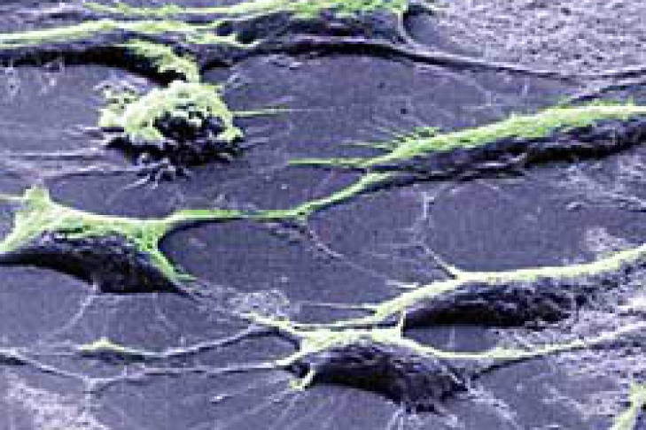

Slide 5
The following properties of stem cells are fundamentally important: these are non-specialized (undifferentiated) cells, they do not do any “work”; they are capable of multiple divisions.
Stem cells have the ability to differentiate, that is, to transform from their general “universal” (“no”) state to a specialized state — namely, and to become cells of a specific organ or tissue.

Slide 6
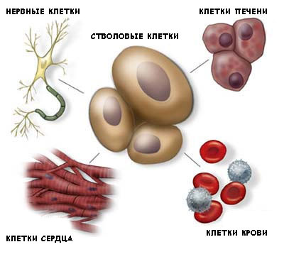
nerve cells
Liver cells
Stem cells
Blood cells
Heart cells

Slide 7
HISTORY OF STEM CELL DISCOVERY
HISTORY OF STEM CELL DISCOVERY
1909 hematopoietic stem cells Maximov A.A.
1909 hematopoietic stem cells Maximov A.A.
Stem cells were discovered 1909
Stem cells were discovered 1909
1968 – mesenchymal stem cells Friedenstein A.J.
1968 – mesenchymal stem cells Friedenstein A.J. et al.
1998 human embryonic stem cells Thomson J.A.
1998 human embryonic stem cells Thomson J.A.
Alexander Alexandrowitsch
Maximow
Alexander AlexandrowitschMaximow
2006 – induced pluripotent stem cells
Takahashi K., Yamanaka S.

Slide 8
STEM CELL SOURCES
Embryo
TARGETED DIFFERENTIATION AND CELL THERAPY

Slide 9
There are very few stem cells in our body: an embryon has 1 cell per 10,000, a 25 year old person has 1 cell per
5,000,000 - 8,000,000.

Slide 10
STEM CELL TYPES
Embryonic stem cells
Adult stem cells
Hematopoietic stem cells

Slide 11
Embryonic stem cells are derived from the so called inner cell mass of a blastocyst, an early stage pre-implantation embryon (4–5 days of segmentation (or postfertilization). These are “ideal” stem cells, from which the whole organism further develops.

Slide 12
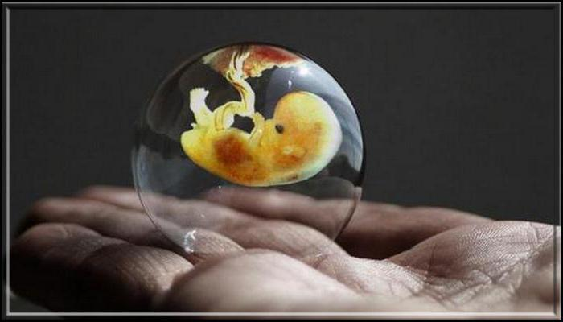
Ethical aspect: it may be material left after the termination of pregnancy (abortion).

Slide 13
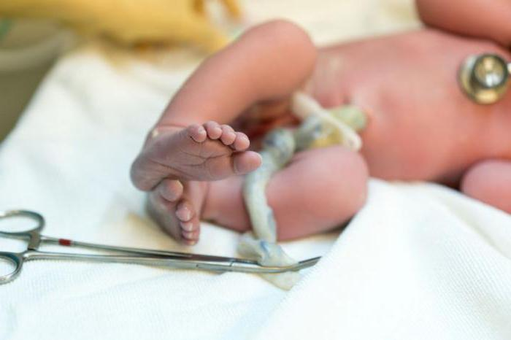

Slide 14
The embryonic stem cell has an unique system of self-control: it actively multiplies, but when an error occurs during cell division, a command is given for self-destruction. This minimizes the risk of cancer when using embryonic stem cells.

Slide 15
ETHICAL ASPECTS OF HUMAN EMBRYONIC STEM CELL USE
Opponents of embryonic cell therapy find it unethical to use aborted fetuses, calling it an attack on human life. They believe that using human embryos to get stem cells can push women into a kind of abortion business to get money in exchange for an embryon, especially since stem cell transplantation is currently considered to be the most promising in the medical industry.

Slide 16
In addition, there is a shortage of donor eggs.
Critics of this method believe that all embryos, whether artificial or natural, have the potential to become full-fledged human beings and it is morally wrong to conduct experiments with them.
They believe that it is necessary to get stem cells from the tissues of adults.

Slide 17
ADULT STEM CELLS
Day-to-day living means the death of cells of various tissues as a result of both natural renewal and damage. In the intestines, skin, muscles, red bone marrow, liver, brain there are tissue-specific cell populations.

Slide 18
HEMATOPOIETIC STEM CELL
are found in the red bone marrow of an adult human.
They successfully undergo cryopreservation (the ability to store their own cells "in reserve" with their use after a long time).
Currently there are no methods for increasing hematopoietic cells in the laboratory

Slide 19
What is the essence of this method?
It turns out that "miracle cells" have two important functions: they divide themselves and activate the reproduction of other cells of the body.
The meaning of the treatment is that when entering a painful organ, the cells activate the immune system and release bioactive substances that induce the renewal of their own stem cells in the affected organ.
As a result of replacing old cells with new ones, a regeneration process takes place, thanks to which the organ is restored.

Slide 20
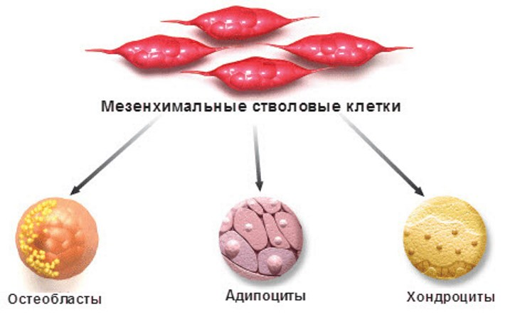
MESENCHYMAL STEM CELLS
Chondrocytes
Osteoblasts
Adipocytes

Slide 21
Cell therapy techniques are used to treat myocardial infarctions, malignant tumors, strokes, injuries and burns.
Today, the range of stem cell treatments has become much wider, and tens of thousands of successful stem cell transplants have been performed in the world for adults and children. Stem cultures are administered to treat strokes, brain and spinal cord injuries. After they enter the affected tissue in patients restore nerve cells and the capillary network in the damaged area of the brain.

Slide 22
However, most recently, Madrid scientists have discovered that stem cells obtained from adults can cause cancer after transplantation. This happens if they are allowed to multiply too long outside the body.

Slide 23
The cost of stem cell treatment is quite high. For example, in Russia it ranges from 240 000 to 350 000 rubles. This high price is due to a rather complicated and high-tech processes for the cultivation of biomaterial.For this price, a person is injected with 100,000,000 cells per course.
The cost of the introduction procedure is paid separately. Stem cell mesotherapy treatments are more available. To obtain a pronounced effect of skin rejuvenation, it is necessary to conduct 5-10 sessions, and the cost of each of them is 15 -30 thousand rubles

Slide 24
Private cryobanks conduct aggressive marketing, which misleads people suffering from serious diseases such as diabetes mellitus, Alzheimer's disease, Parkinson's disease and others.
In fact, the treatment of these serious ailments is carried out only at the experimental level, and such methods go through research and development stages.

Slide 25
Cryobanks are specially equipped stem cell stores. In Europe and America, cord blood stem cell cryobanks began to appear more than 10 years ago. Today, there are 45 in total. These banks store cord blood samples harvested from newborn donors, the data of which are included in the National Hematopoietic Cell Donor Registers.

Slide 26
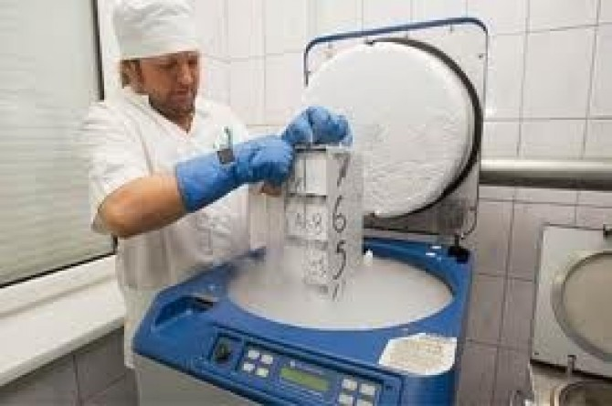

Slide 27
By signing a contract with such a bank, parents can save stem cells for the future for their child. Cells are thoroughly examined, frozen according to a special program, stored in liquid nitrogen at a temperature of -196°С in a state of complete suspended animation, and can be used to treat the child himself or his immediate family.

Slide 28
Currently, in addition to cosmetic procedures, medical clinics offer treatment of serious diseases with stem cell injections. The price lists indicate that diabetes and cancer can be cured by such injections.
But there are no confirmed data on recoveries. On the contrary, there is an opinion of experts that rejuvenation with stem cells causes cancer.

Slide 29
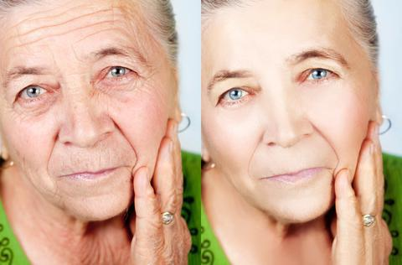
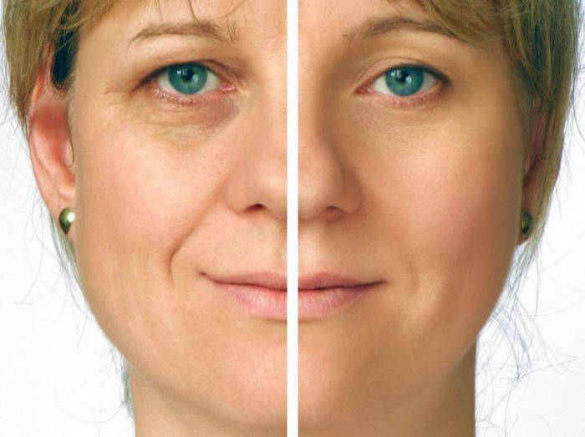
Rejuvenation with stem cells

Slide 30
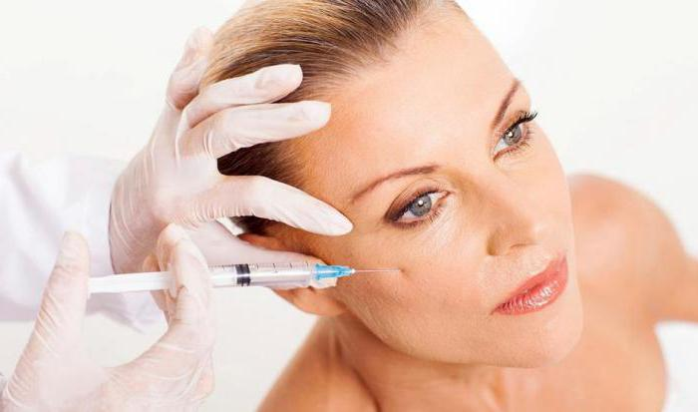
Rejuvenation with stem cells

Slide 31
.ROULETTE OR DEATH GAME
There are different statistics of the consequences of using embryonic stem cells - according to one source, 30% of patients become cancer patients, according to other sources, the incidence of cancer after this therapy increases three fold.

Slide 32
Analyzes of famous patients showed that the body is updating, vital activity is accelerating. However, scary statistics soon appeared: those who used stem cells first became really young, and then quickly “burned” from cancer. They had rapid growth of cancer cells. Dmitry Hvorostovsky, ZhannaFriske, Alexander Abdulov, Oleg Yankovsky, LyubovPolishchuk, KlaraLuchko, Vladimir Turchinsky (Dynamite), Yuri Aizenshpis, Anna Samoilova - all of them used stem cells and passed away quickly.

Slide 33
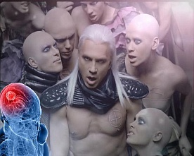
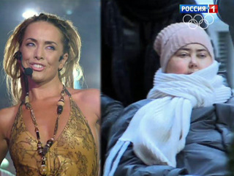
Doctors diagnosed brain tumor with world famous opera singer Dmitry Hvorostovsky
They buried pop singer Jeanne Friske, who a year ago was diagnosed with the same
Alexander Abdulov and Oleg Yankovsky

Slide 34
Scientists around the world call the 21st century the century of biomedicine. This is understandable, because this area of medicine is developing at an incredible rate. No wonder that in recent years, scientists have received 7 Nobel Prizes for their discoveries in the field of cellular technology! And this is far from the limit, because the prospects for stem cell treatments today seem absolutely limitless!

Slide 35
Thanks for your attention!

